Slide 1

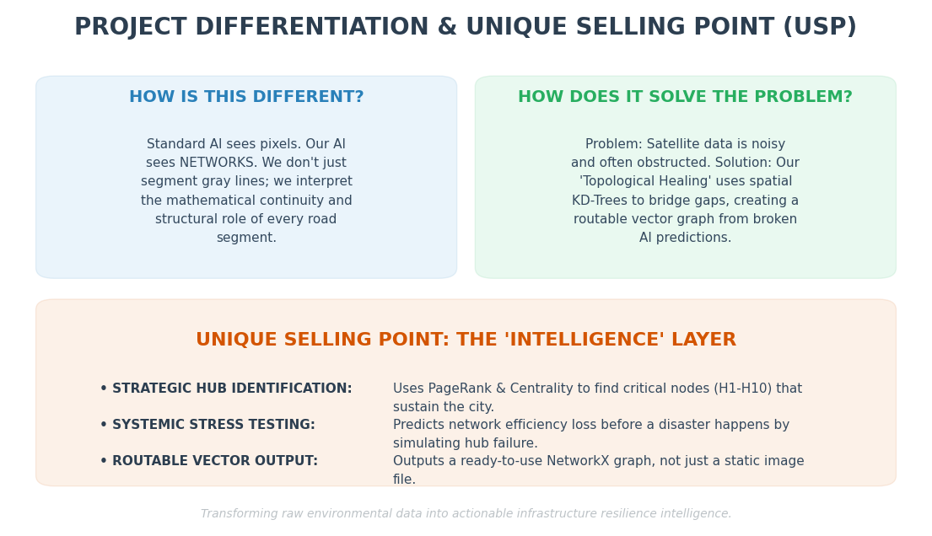
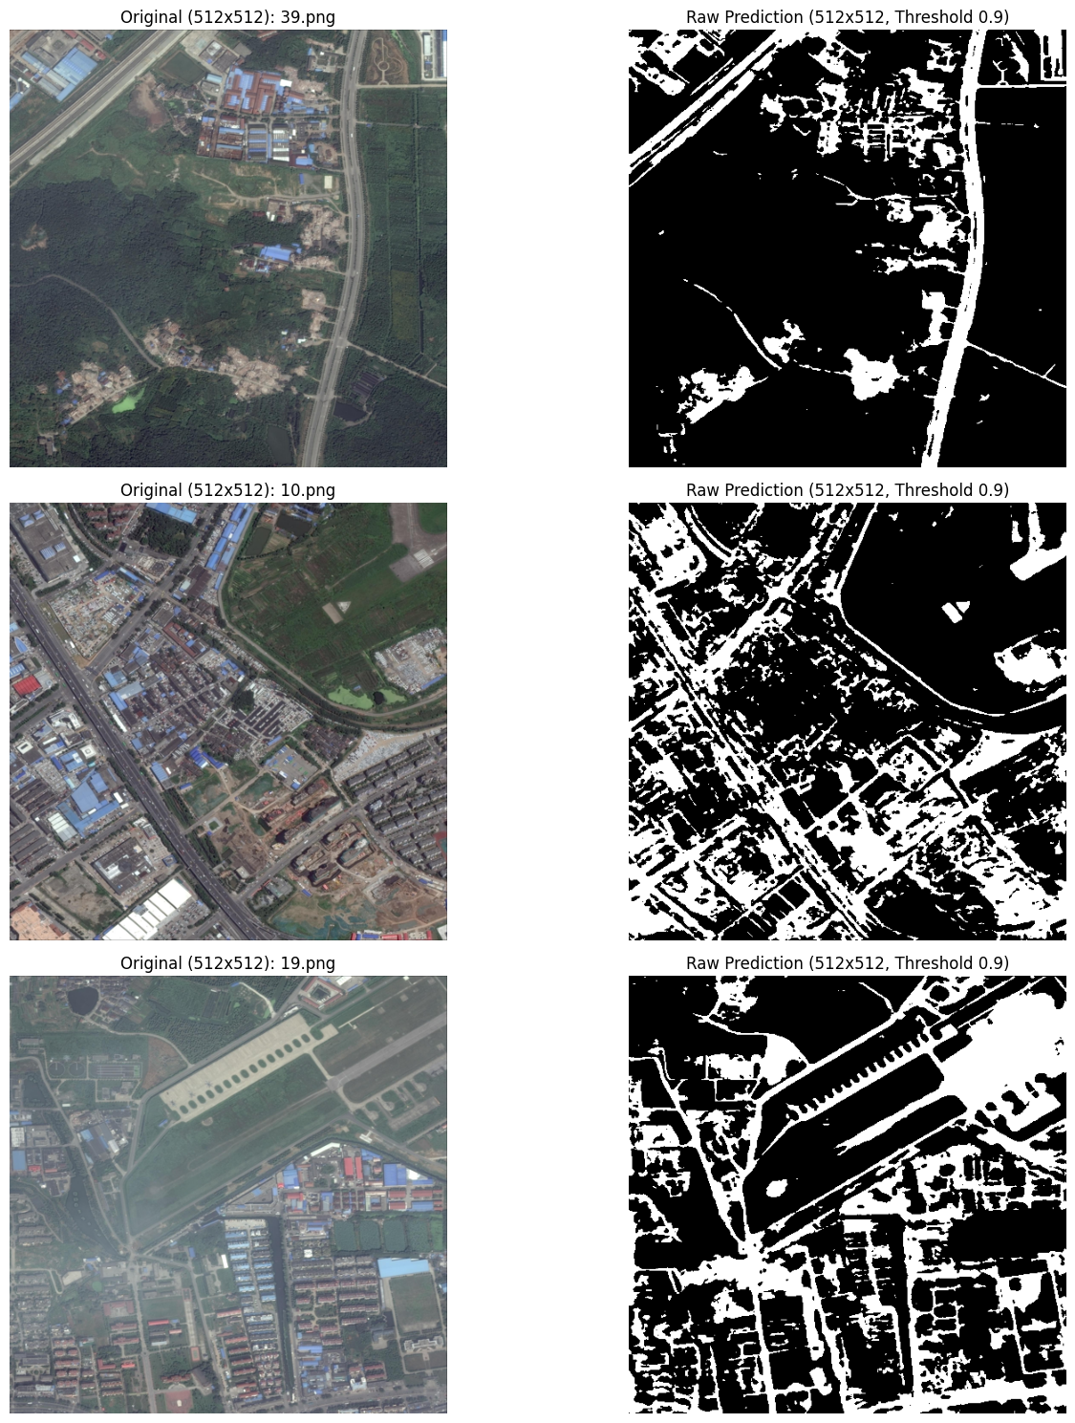
Dynamic Output Validation: Preserving connectivity across areas of dense foliage and building shadows. Direct comparisons of raw segmentation and fully mapped graph models are recorded verbatim in image.

Slide 2
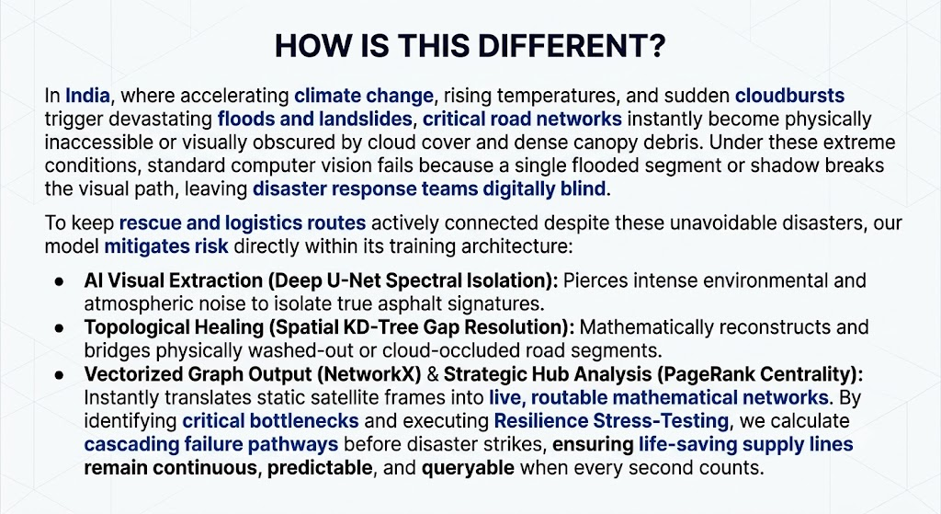
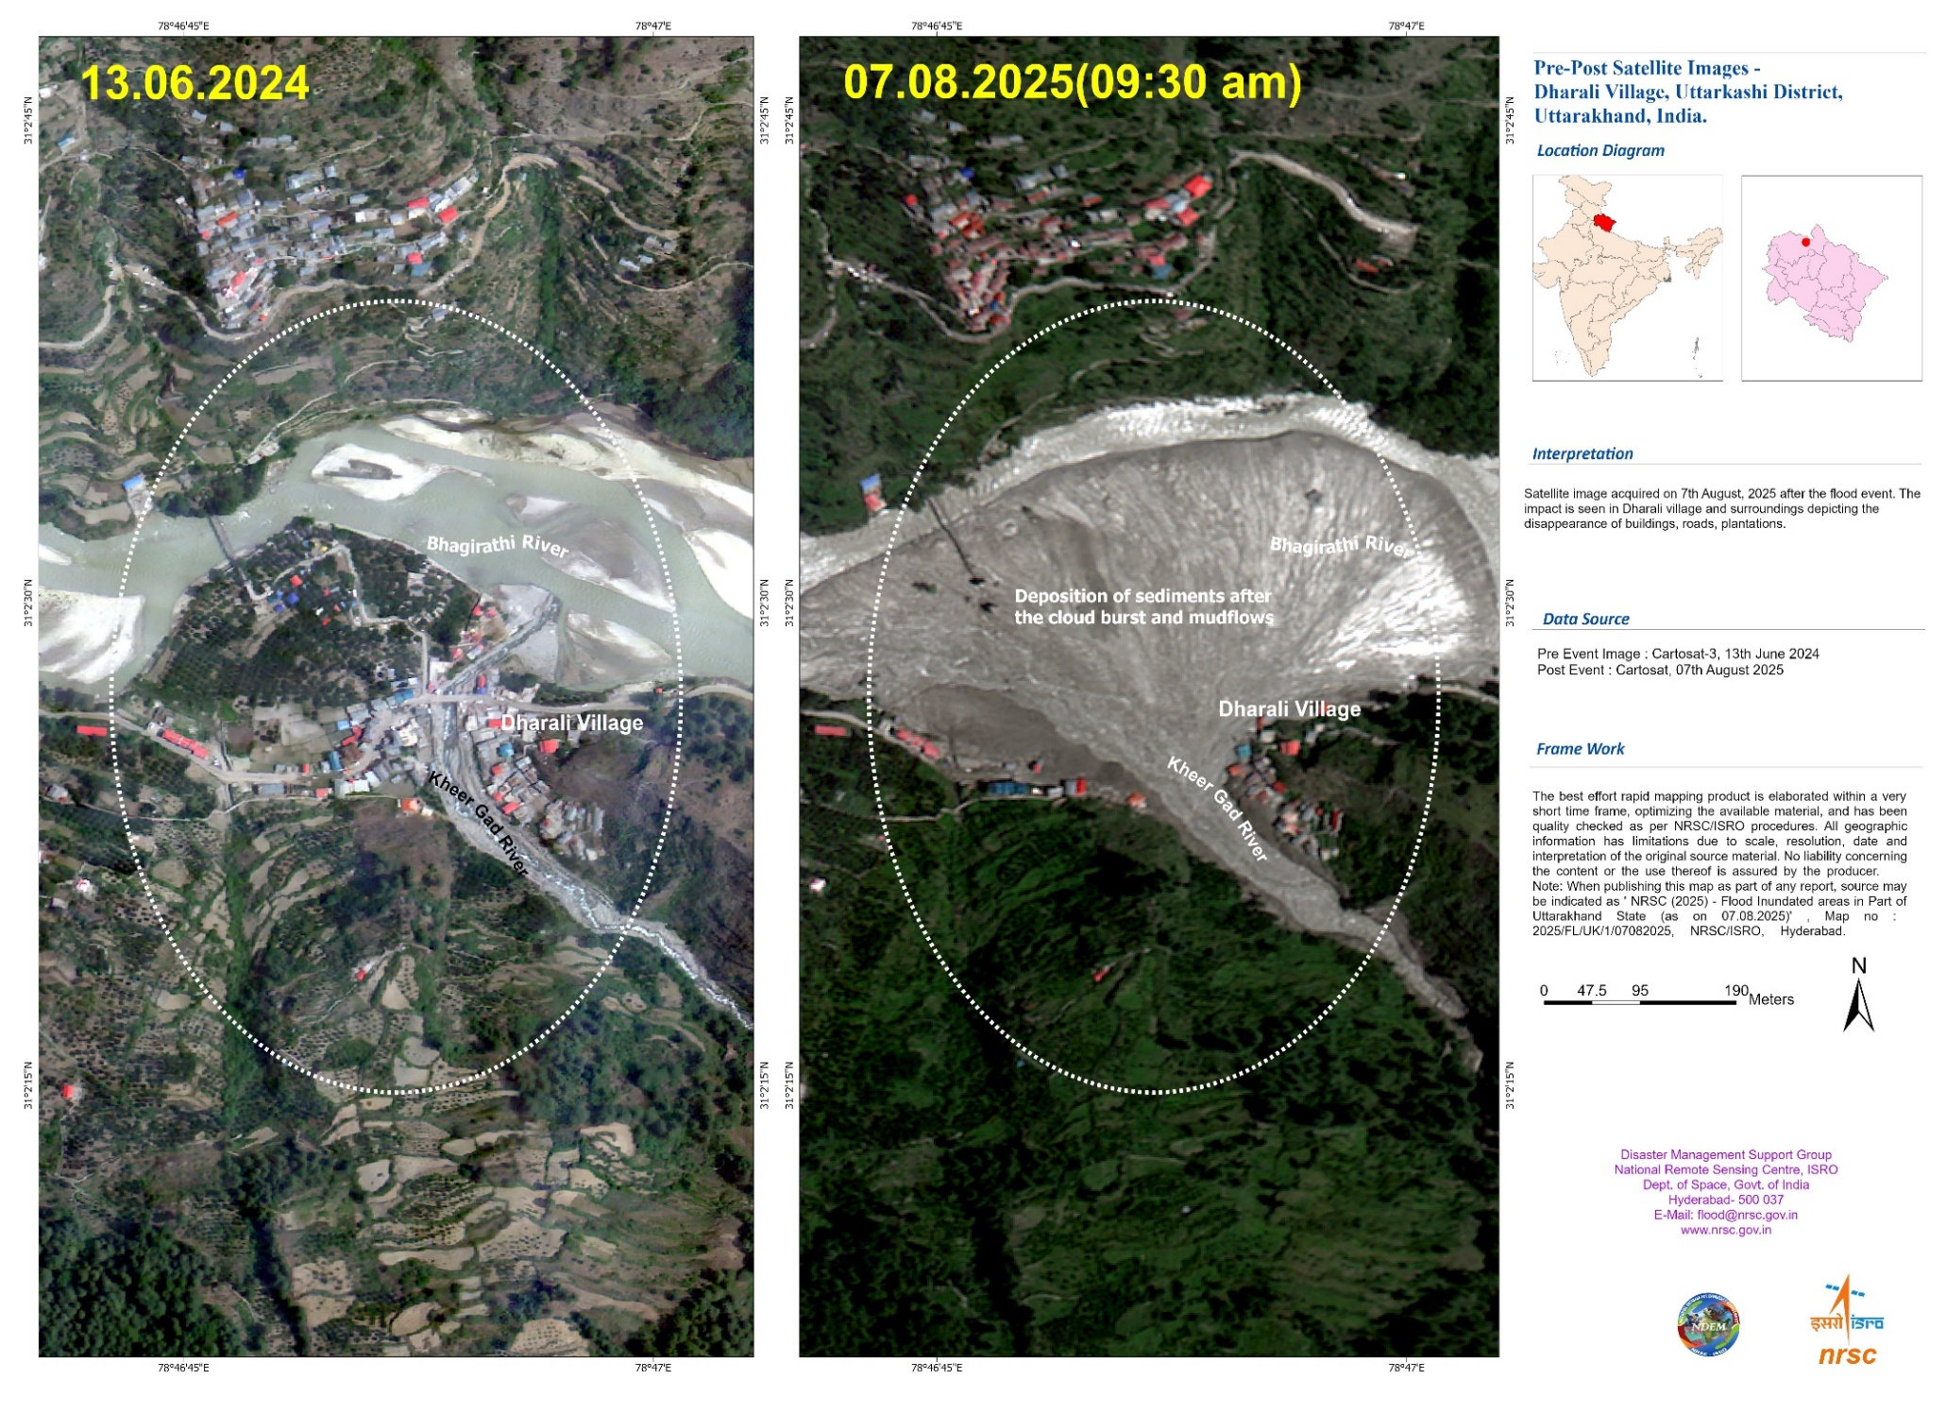
PROJECT DIFFERENTIATION AND UNIQUE SELLING POINT ( USP)
A catastrophic flash flood triggered by intense rainfall caused debris-laden flows over Dharali and Harsil villages, in Uttarkashi district, Uttarakhand, on the 5th August 2025. The sudden deluge swept away homes, buildings, bridges, roads, and claimed human lives.
SOURCE: https://www.isro.gov.in/indian_satellite_data_based_analysis_of_the_dharali_flash_flood.html

Slide 3
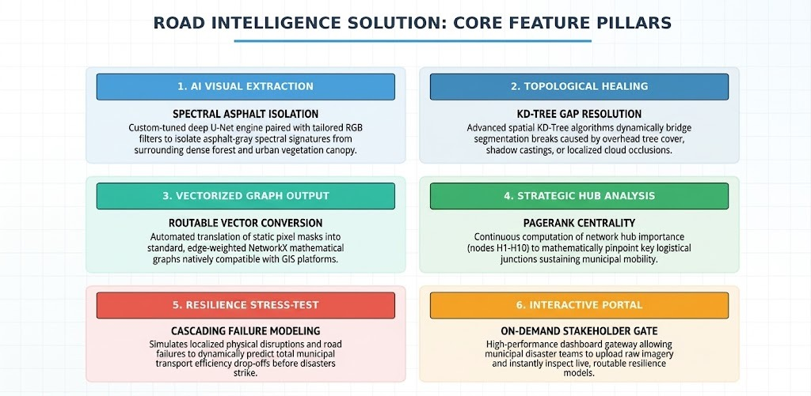

Slide 4
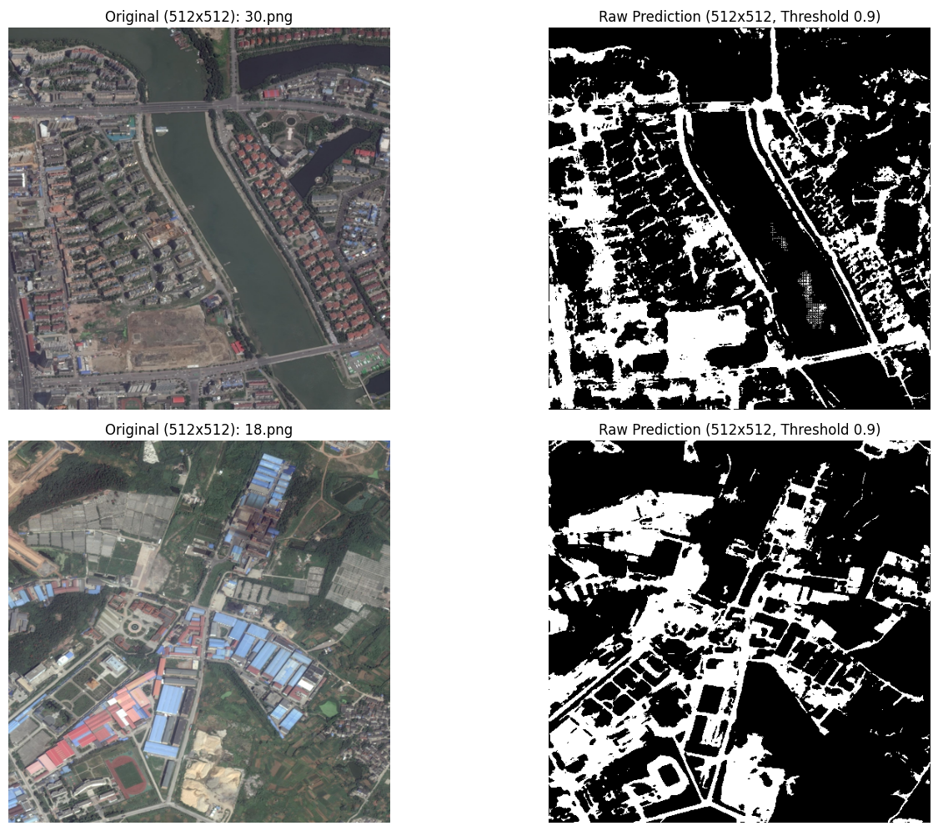
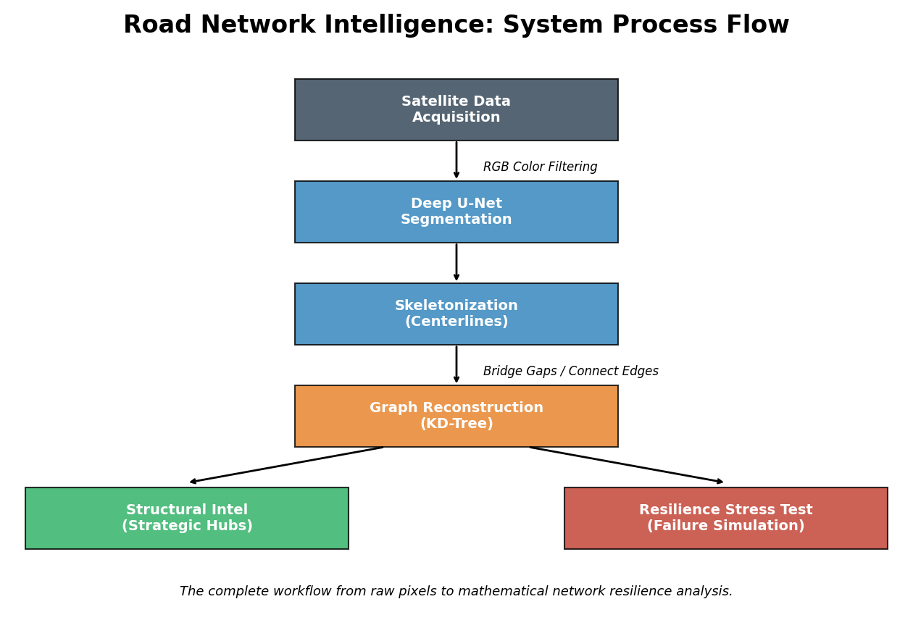
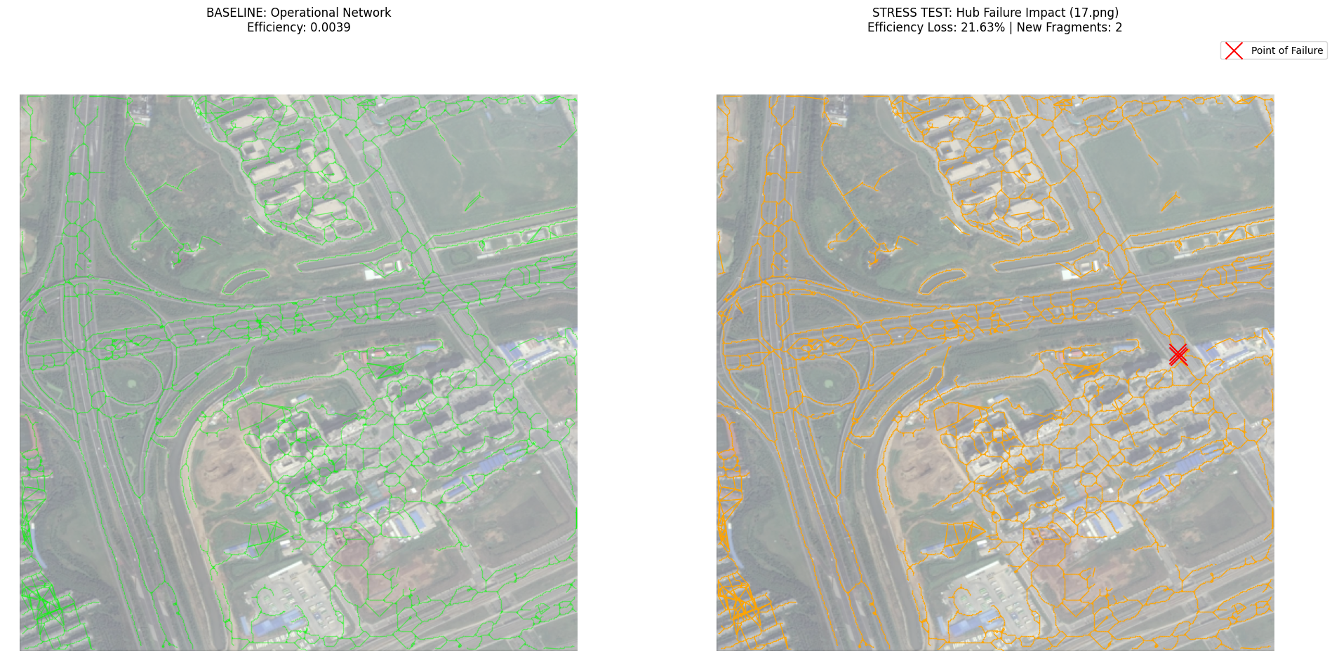
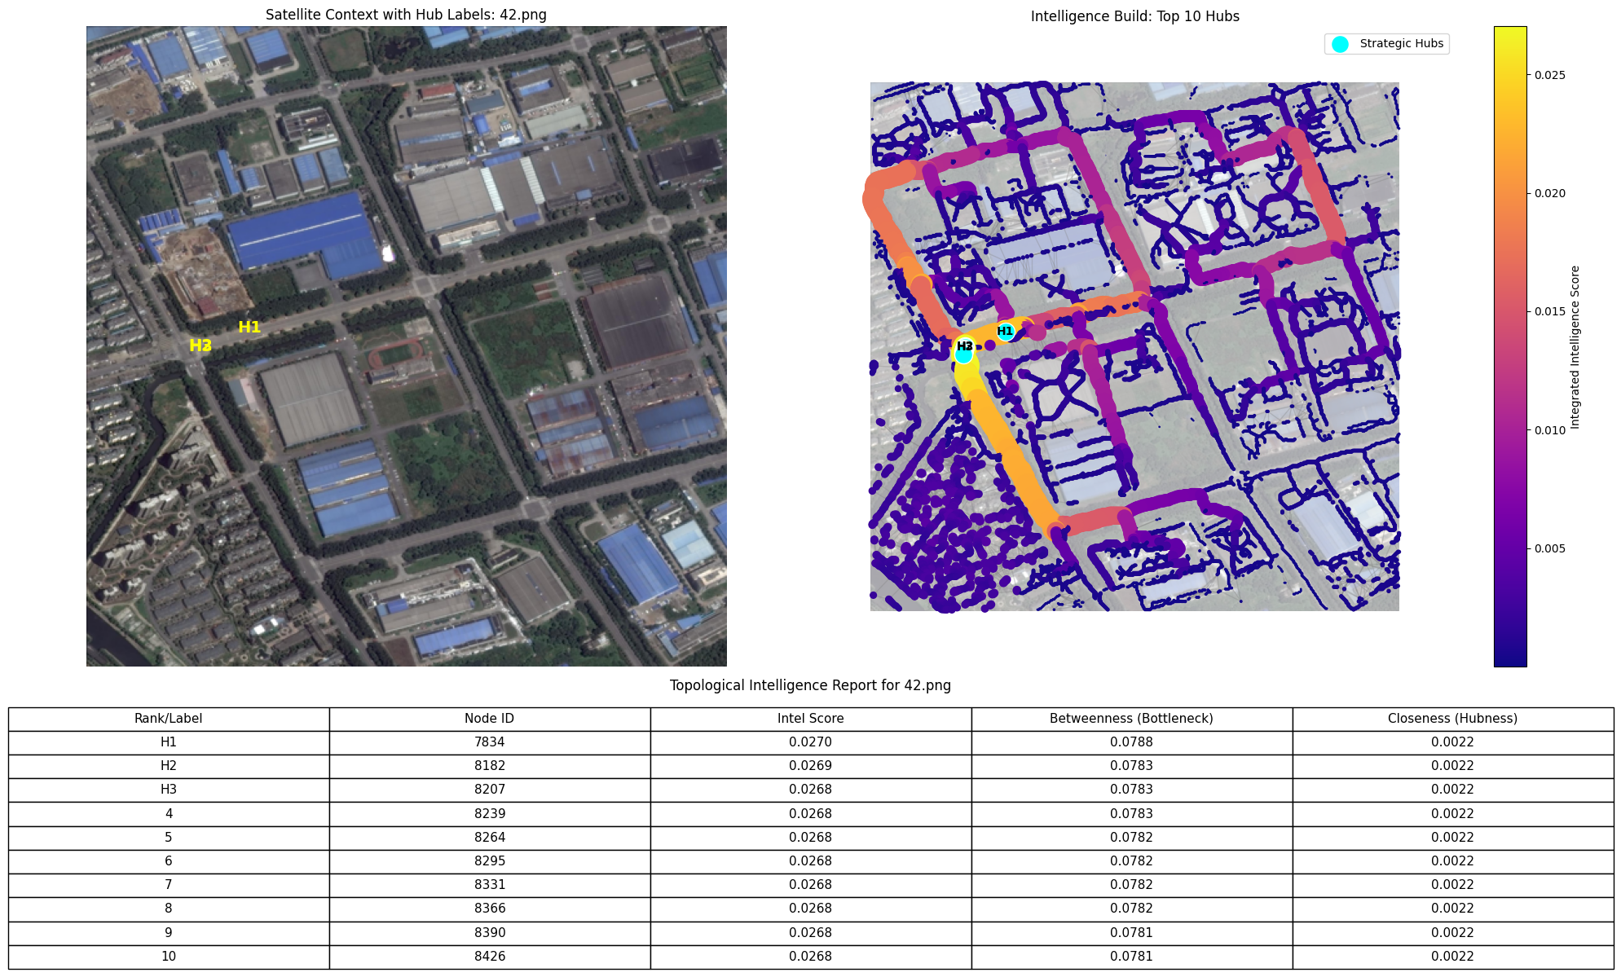
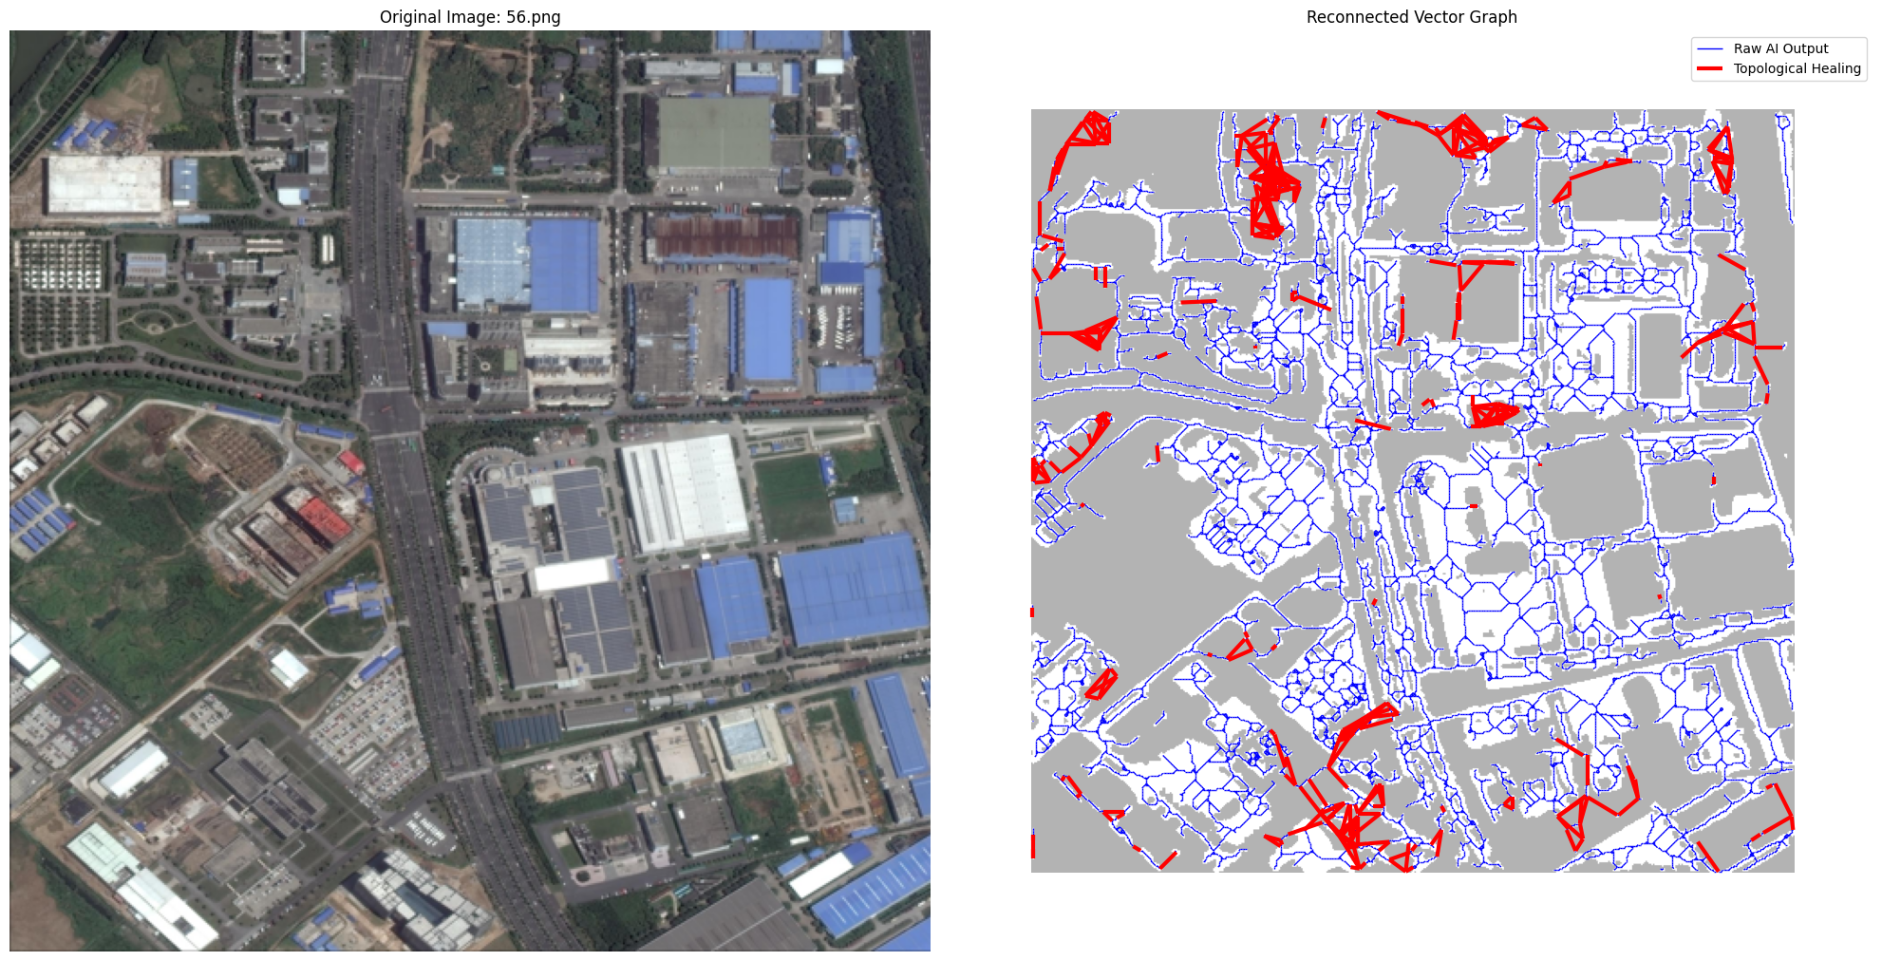
Resilience Stress Test
U-Net Segmentation
Graph Construction
Structural Intel

Slide 5
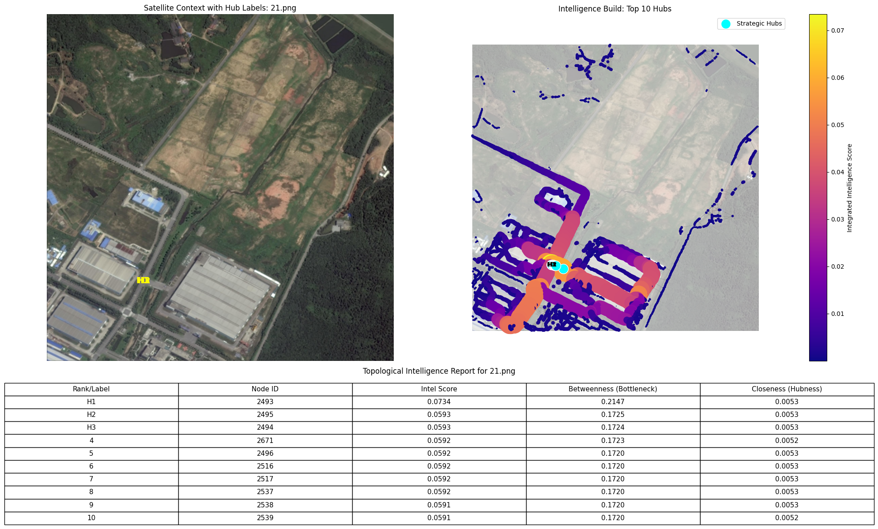
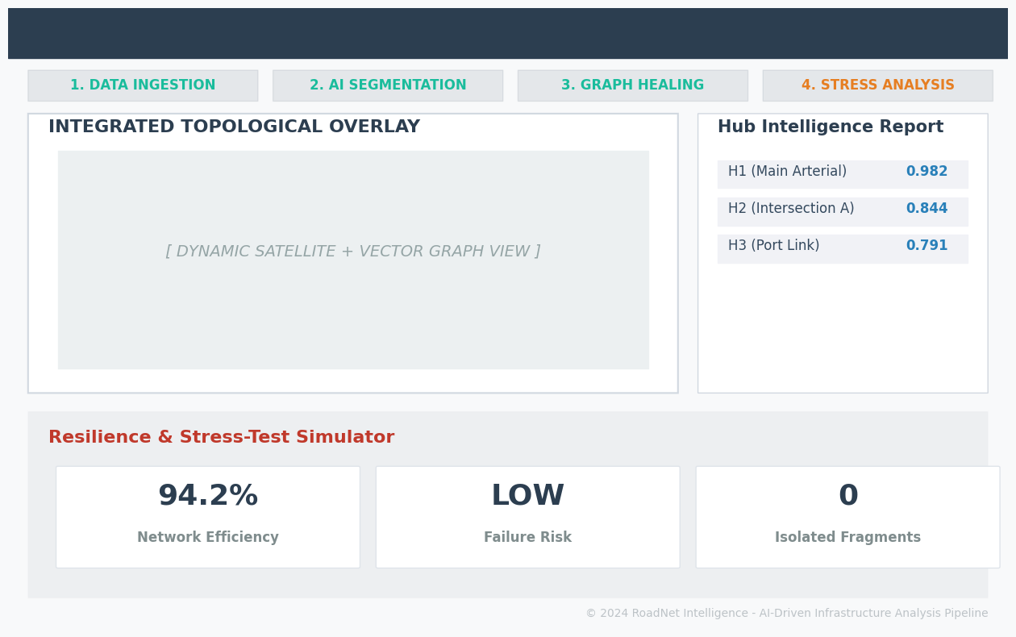
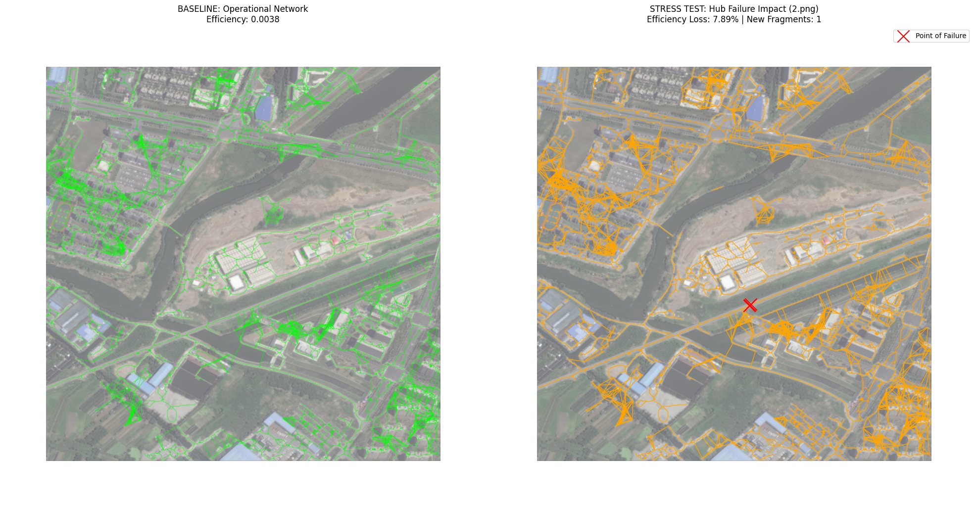
Road Network Simulation Framework
Structural Intelligence Hub
Systemic Resilience

Slide 6
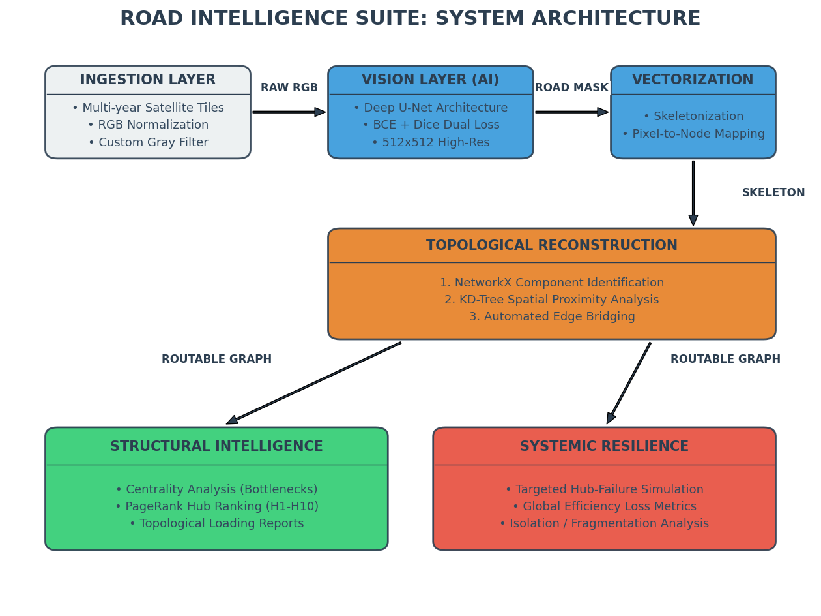

Slide 7
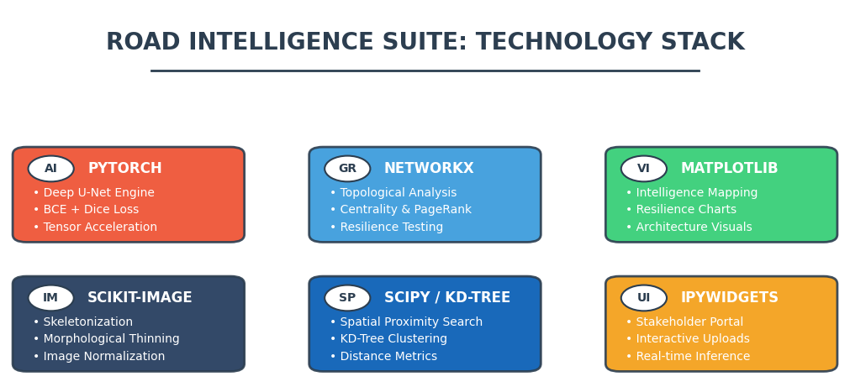

Slide 8
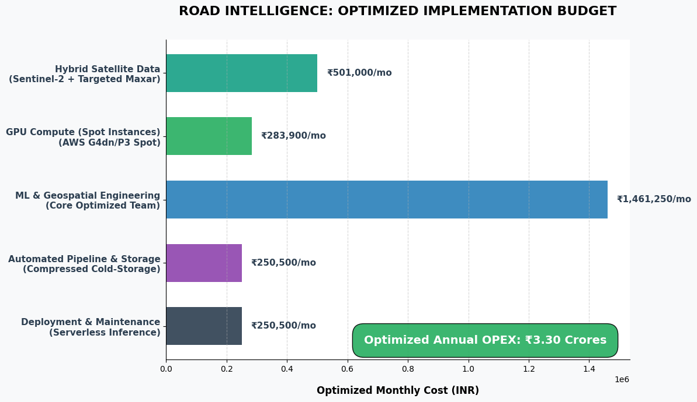

Slide 9


